Slide 1

Sagely Solutions
-Smart water utility & monitoring system
Presentation by:
Polneni Srividya
Mittapally Sandeep
Shashi preetham

Slide 2
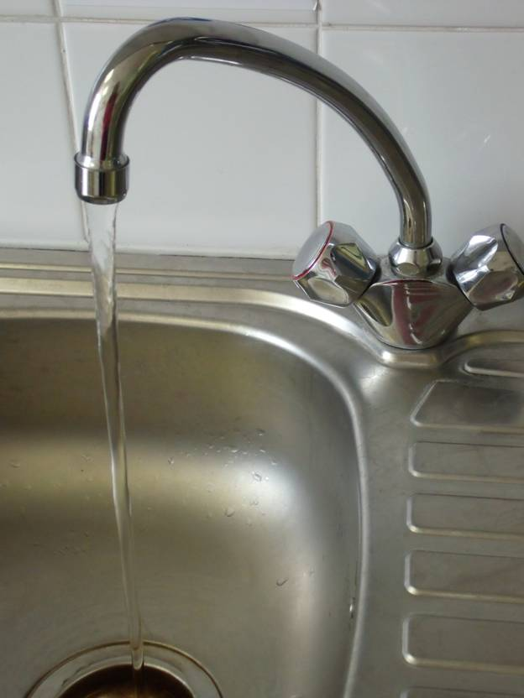


Slide 3
Causes
Growing Population
Adverse Environmental Conditions
But most importantly wastage of water!
According to the survey , From “The Hindu”
a human being waste 15-60 liters of water unnecessarily per day
30*365=10,950 liters(on an average)which is equal to 7,300 -12,000litres of water per year.

Slide 4
What did we do?
“ What gets Measured gets Managed “
Define consumer profiles
Measure water consumption
Deduce optimum water usage metrics per customer
Help authorities to Negatively Incentivize the wastage

Slide 5
Who needs this??
Housing societies & gated communities
Apartments blocks
Industrial Areas
Water Distribution & Management Departments of Cities
Facilities Management Companies

Slide 6
What did we build ?
An IoT-enabled Water Meter
A Mobile App for review, monitor and control flow
Cloud storage of consumption data
Web App to monitor aggregate consumption data

Slide 7
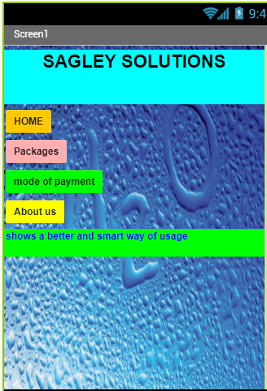
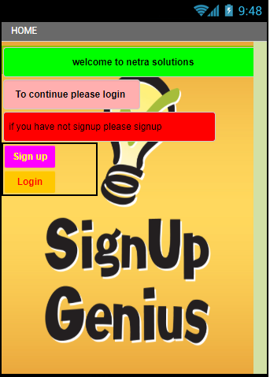
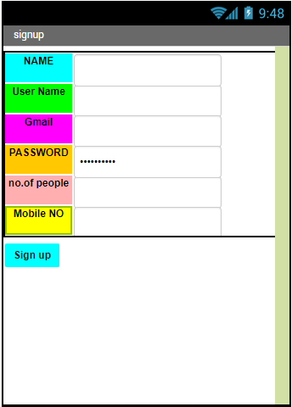
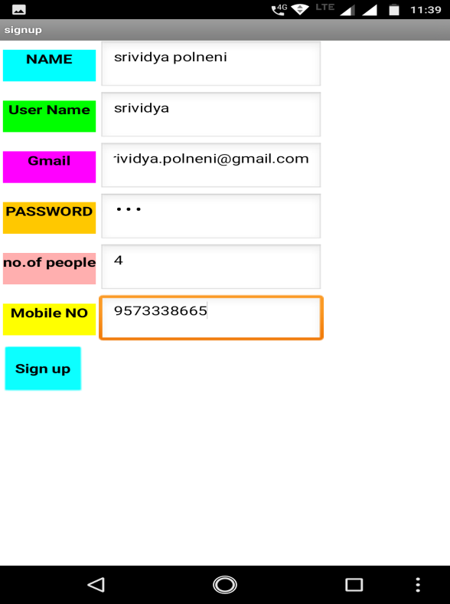
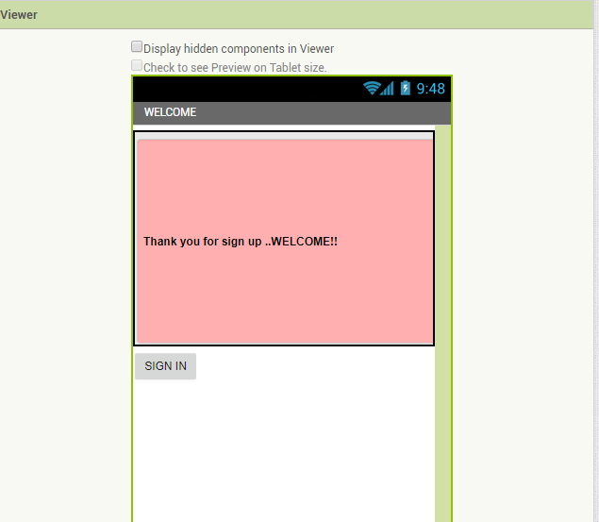
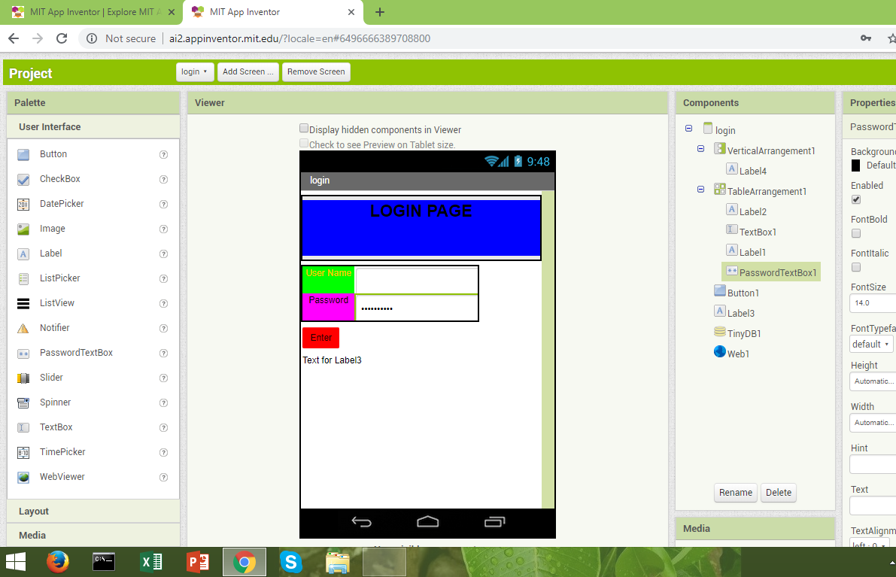
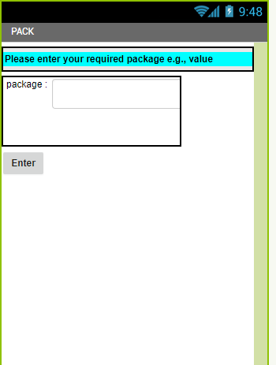
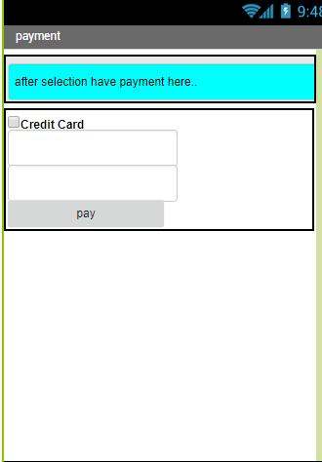

Slide 8
How does it work?
Step 1:
Devices are installed at the consumer points
Step 2:
Register users
Step 3:
End user uses app
Step 4:
Society manager aggregates Consumption
Consumption Data is stored in cloud. Insights derived on standard metrics.

Slide 9
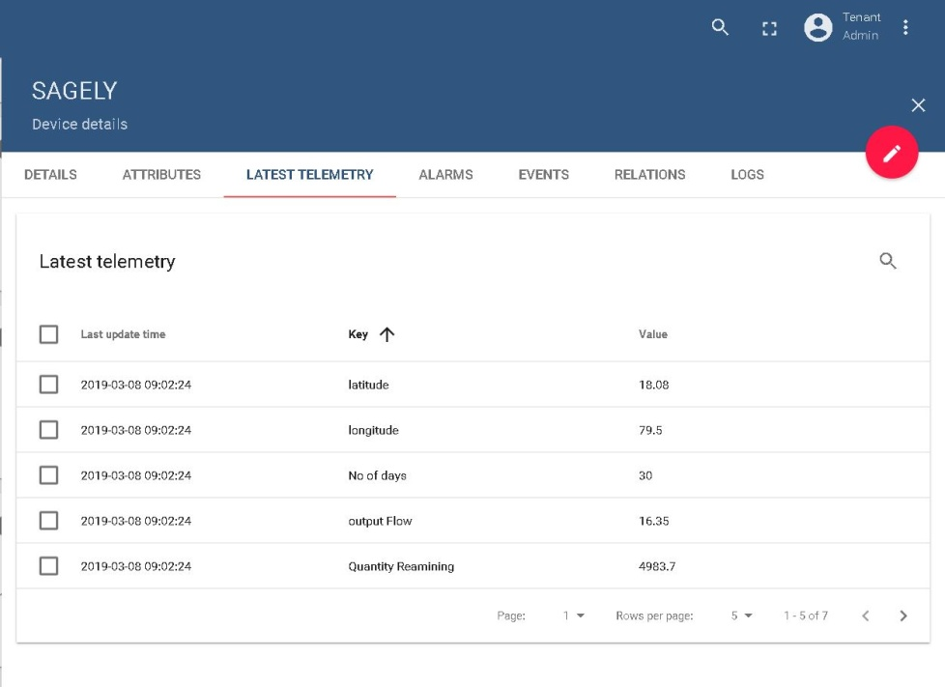
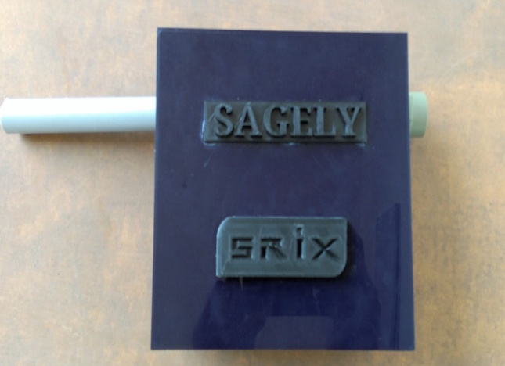
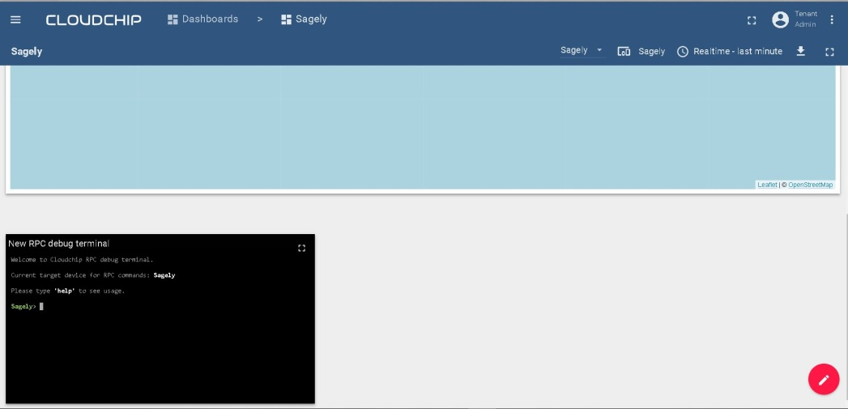
Our App

Slide 10

Working Video

Slide 11
THE TEAM
1. Mittapally Sandeep ( B.TECH,ECE-3rd year)
Email: sandeepmittapally99@gmail.com, Linkedln: Sandeep Mittapally
2. Polneni Srividya ( B.TECH, CSE-3rd year)
Email : Srividya.polneni@gmail.com , Linkedln: srividya polneni
3. Sashi Preetham( B.TECH, CSE-4th year)
Email: preetham.p1997@gmail.com , Linkedln:Sashi Preetham

Slide 12
THANK YOU..!!
“If there is magic on this planet, it is contained in water.”
Loren Eiseley

